Slide 1
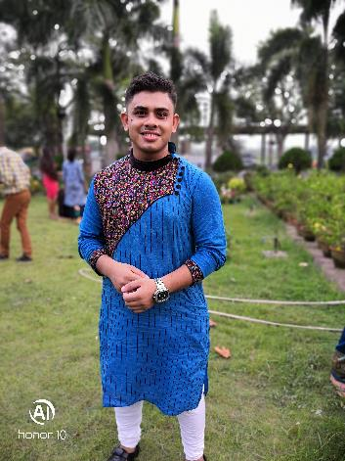
SATYAKI MANDAL
M1056069

Slide 2
ABOUT ME
I am a resident of Bally, Howrah, West Bengal.
I love to spend quality time with my family as well as my fellow beings.
I love to spend my leisure time by doing photography and painting.
Age : 23 yrs.
Languages : Bengali, English, Hindi.
Family:
Father
Mother
Pet cat

Slide 3
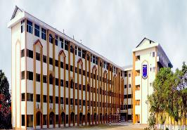
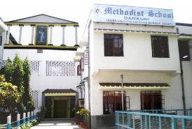
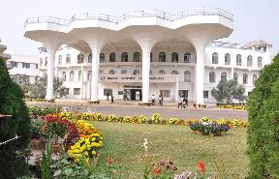
EDUCATION
10TH SCHOOLING
SACRED HEART SCHOOL, SILIGURI
12TH SCHOOLING
METHODIST SCHOOL, DANKUNI
B.TECH
HALDIA INSTITUTE OF TECHNOLOGY, HALDIA

Slide 4






TECHNICAL SKILLS
Java Core
HTML5 ,CSS3 Bootstrap
Spring Boot , JPA, Spring Boot MVC
MySQL

Slide 5
HOBBIES AND INTERESTS
Games Outdoor Games: Volleyball, Football, Badminton
Workout Gym
Hobbies
Photgraphy and panting along with graffiti.
Gaming FIFA, Call Of Duty
Listening To Music, Watching movies English and Hindi

Slide 6
STRENGTHS
Confident
Friendly
Kind
Team Worker
Positive Attitude

Slide 7
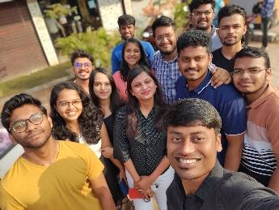
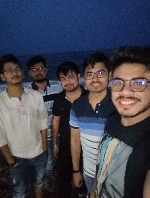
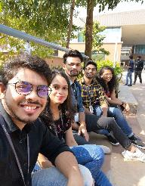
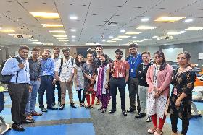
OVERALL EXPERIENCE AT KALINGA
It was a wonderful experience.
Leads were very much helpful and got to learn so much from them.
Learnt new technologies.
Learnt how to manage time.
Made lot of friends.

Slide 8
CONTACT
CELL PHONE
+91 8436 686 646
EMAIL
Satyaki.Mandal@mindtree.com

Slide 9
THANKS!

